Slide 1


HELP INternational: Funding Campaign for countries that needs it
Finding out who needs help
THE MOST

Slide 2

AGENDA TOPICS
Who are we?
Goal
Analysis
Solution
Summarization
Notes:
We are the DNL consulting Firm, and we would like to showcase the project we have undertook on behalf of World Travel Insurnases , in order to develop a Classification model that will skyrocket the insurance company’s revenue.

Slide 3

1. Who we are?
DNL Consulting Co.
Dimitrios Thymioudis, Data Scientist
Nikolaos Christoforou, Data Scientist
Leonidas Bourikas, Data Scientist

Slide 4

2. Goal
HELP INternational
NGO committed to fight poverty and provide the people of backward countries with basic amenities and relief.
Has raised 10 million through fundraising.
Need help to decide the distribution of the money.
DNL Consulting Co.
Categorization of the countries based on socio-economic and health factors to determine overall development of the countries.
Suggestion of the countries which the company needs to focus on the most.
Notes:
Help int. Has raised 10m through fundraising from social media, press and Tv commercials
Their worry was: “How to distribute money in an honest and subjective way” so that they will help those that need them the most
DNL was here to give the solution through a small yet representative data
Collection on foundamental indices of quality of life
Our main goal is to classify the 167 country data in “those in priority of funding (in need) and “those countries that don't need them”.

Slide 5

3. Analysis (1/4) - Data Source
Country Dataset (10 Features of 167 Countries)
Name of the country.
Death of children under 5 years of age per 1000 live births
Exports of goods and services per capita.
Total health spending per capita.
Imports of goods and services per capita.
Net income per person.
The measurement of the annual growth rate of the Total GDP.
The average number of years a new born child would live if the current mortality patterns are to remain the same.
The number of children that would be born to each woman if the current age-fertility rates remain the same.
The GDP per capita.
DataSource
Open data from https://www.kaggle.com/datasets/rohan0301/unsupervised-learning-on-country-data

Slide 6
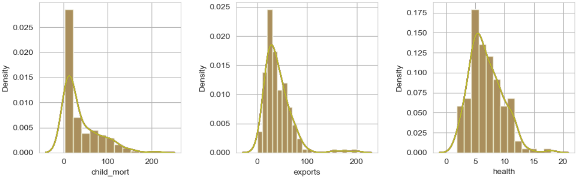
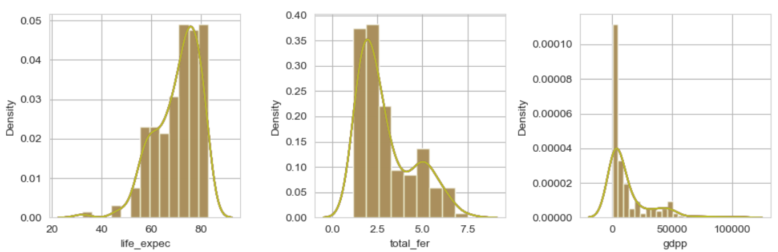
3. Analysis (2/4) - Feature Distributions
Insights:
Skewed distributions

Slide 7
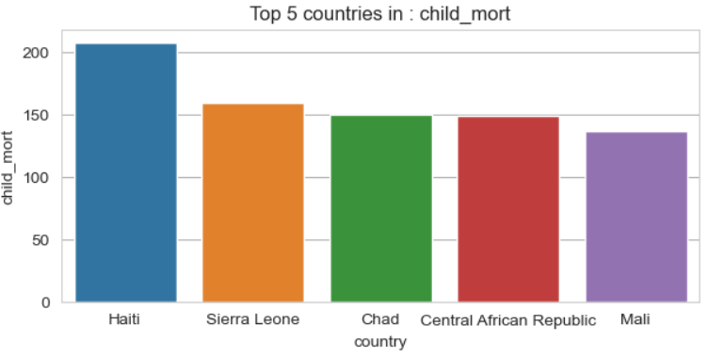
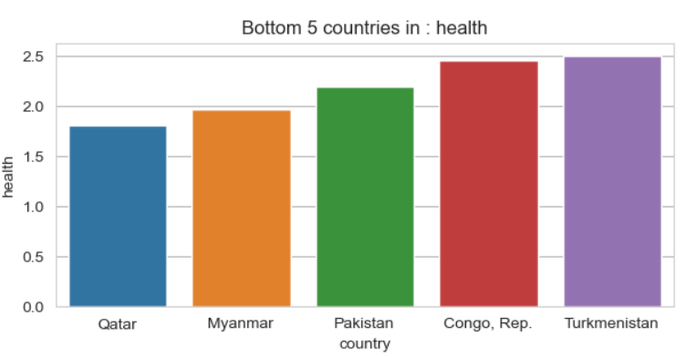
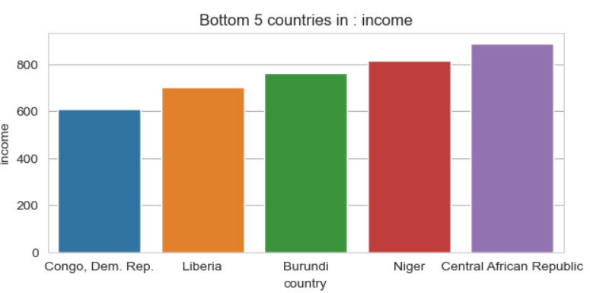
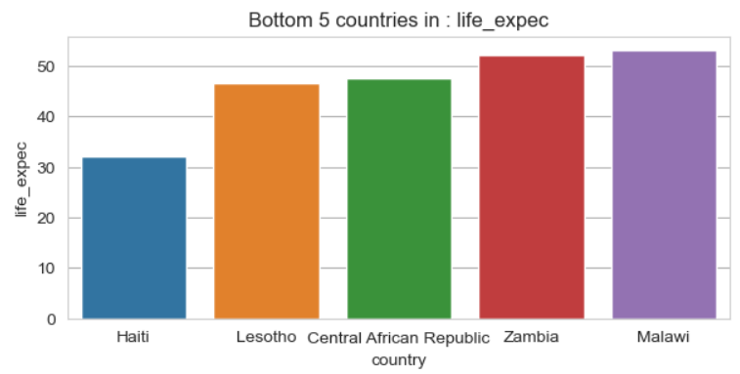
3. Analysis (3/4) - Top 5 Underdeveloped Countries

Slide 8
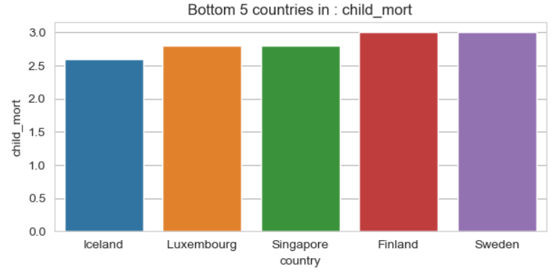
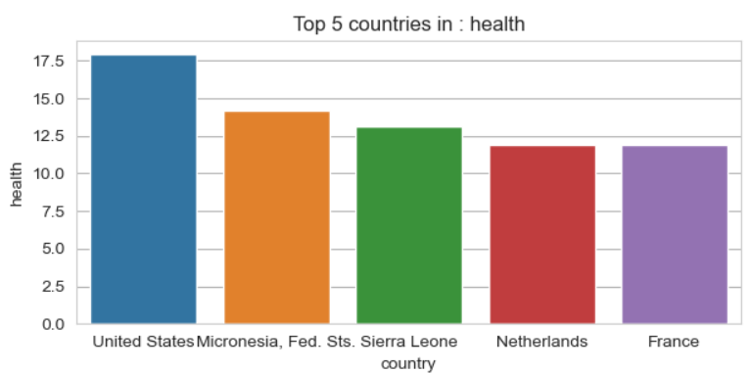
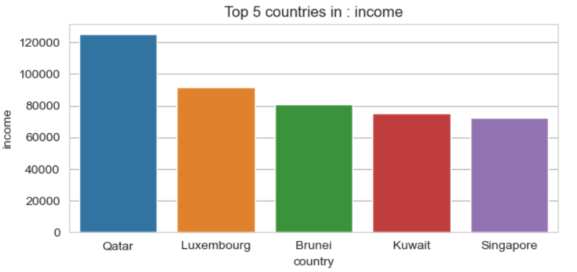
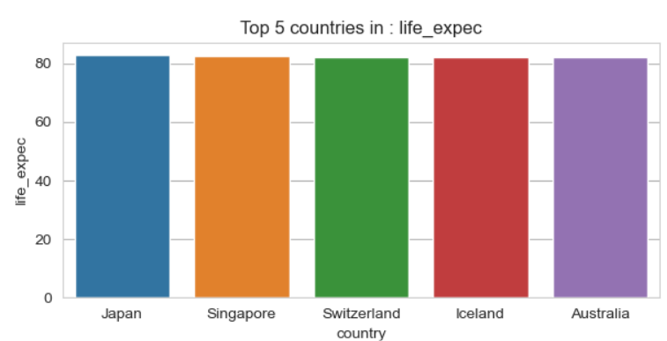
3. Analysis (4/4) - Top 5 Developed Countries

Slide 9
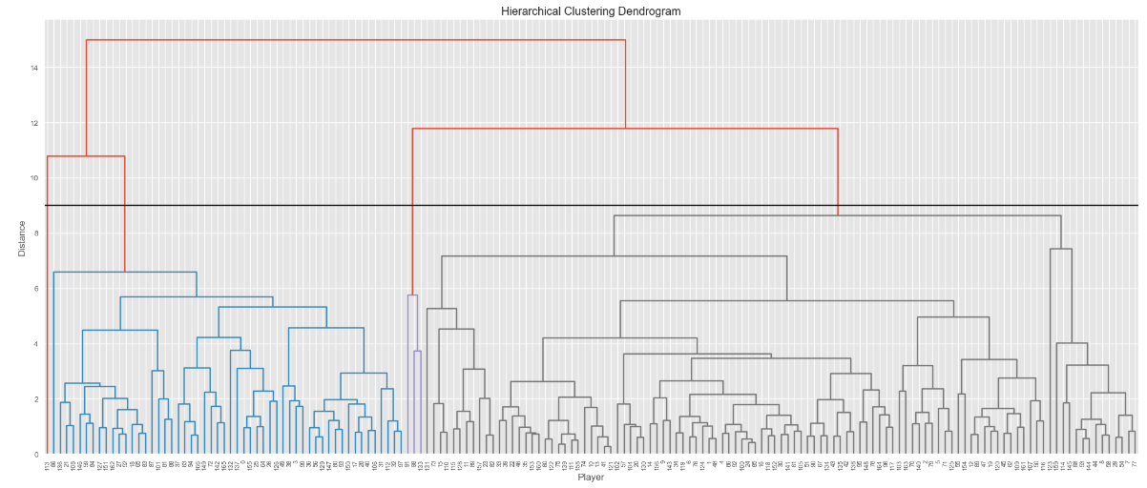
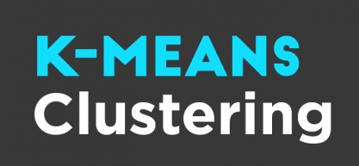
4. Solution (1/4)
Clusters for Countries
Two ML models to cluster the countries based on their characteristics
K-Means
Hierarchical Dimensional Trees

Slide 10
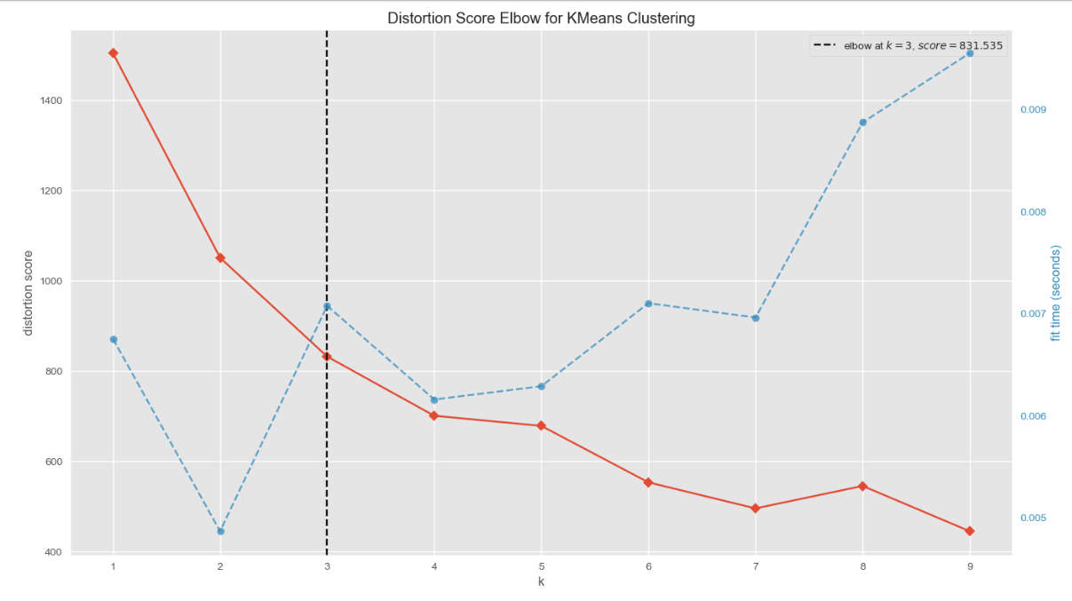
4. Solution (2/4)
Best Number of Clusters: 3

Slide 11
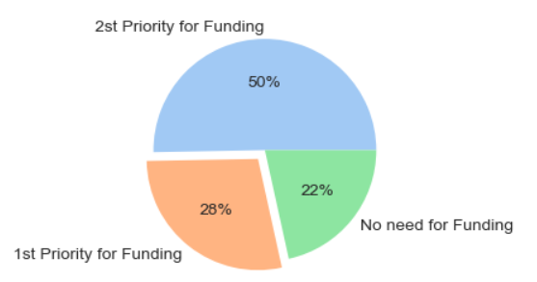
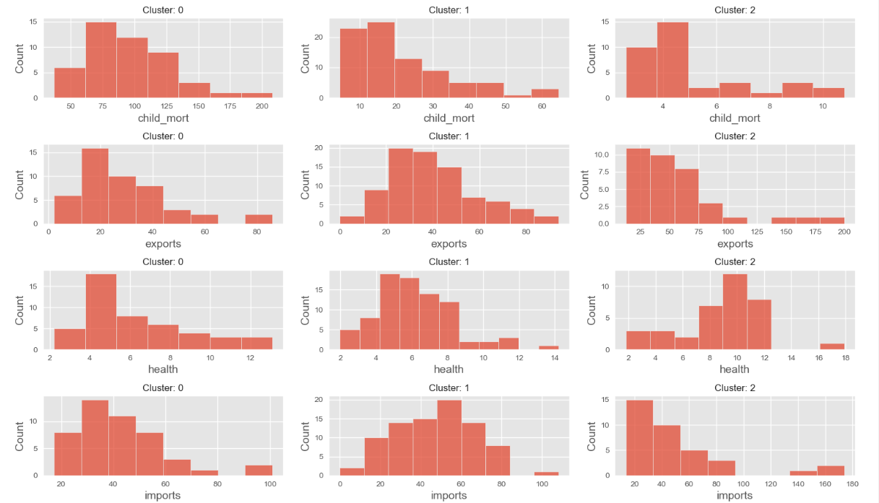
4. Solution (3/4)
Final cluster names
Based on above findings (GDPP, Child Mortality, Income, Health), clusters can be named as follows:
* Cluster 0: Underdeveloped -> 1st Priority for Funding
* Cluster 1: Developing -> 2st Priority for Funding
* Cluster 2: Developed -> No need for Funding

Slide 12
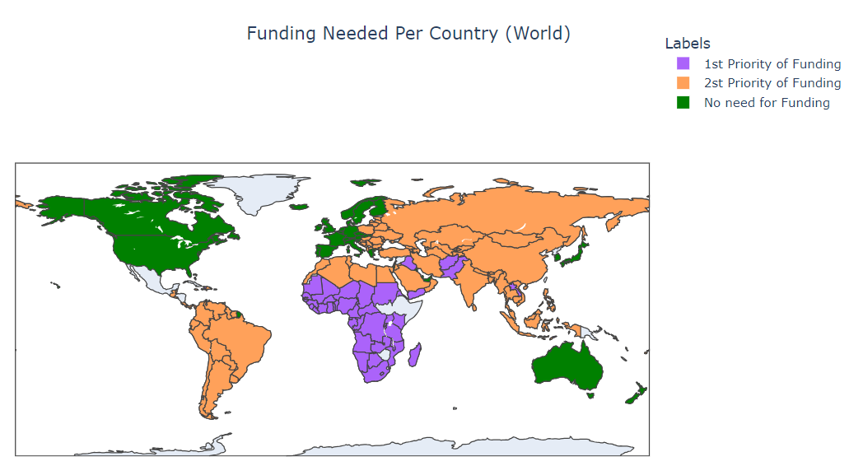
4. Solution (4/4)

Slide 13
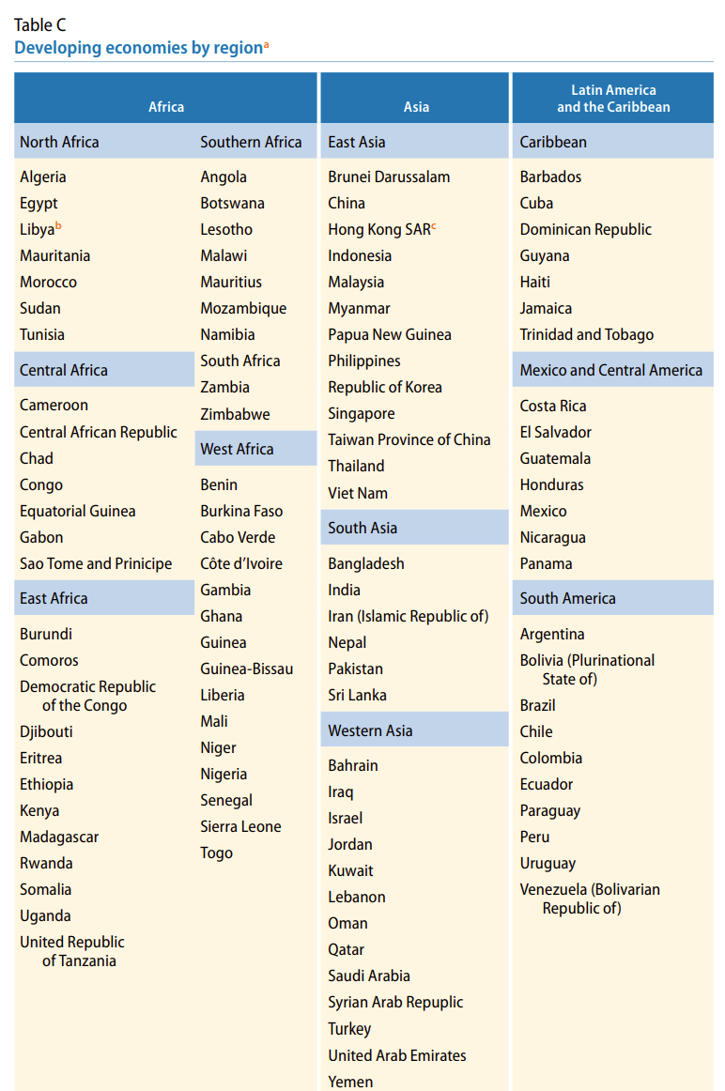
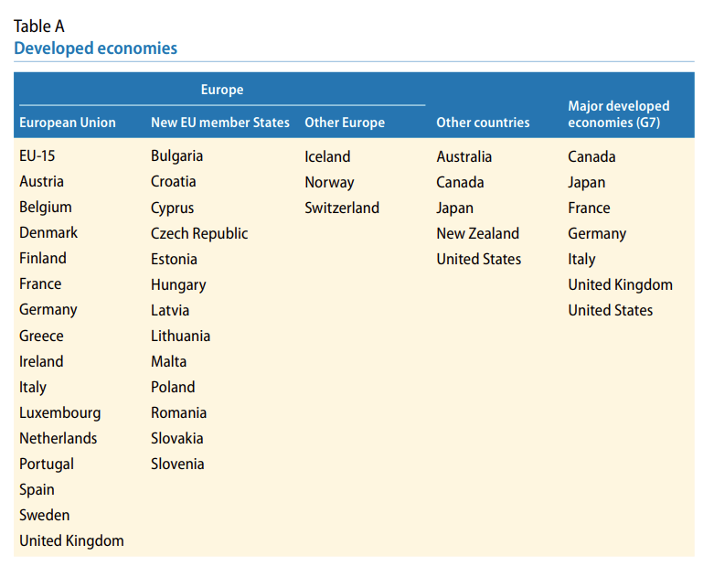
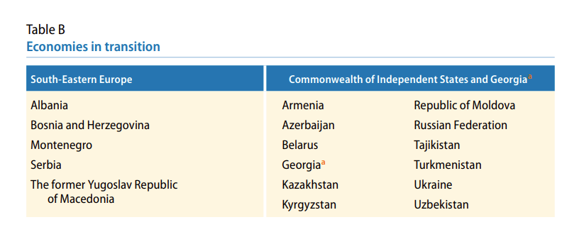
ACCORDING TO: United Nations: Country classification (2014). World economic situation and prospects (WESP).
https://www.un.org/en/development/desa/policy/wesp/wesp_current/2014wesp_country_classification.pdf
2..Developing
1.Developed
3. In transition

Slide 14

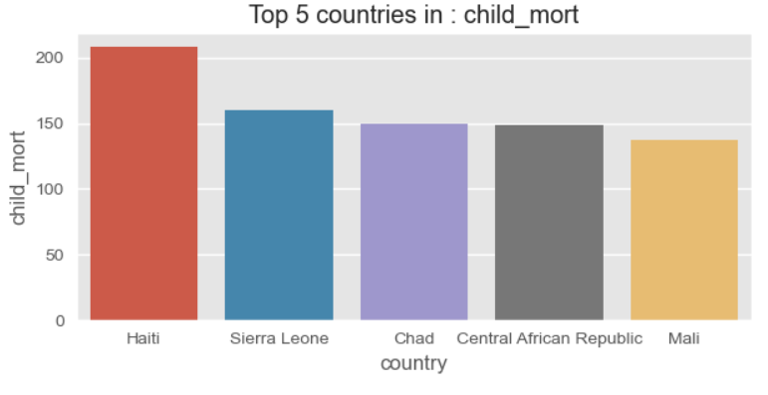
4. Conclusion
Top 5 Countries in child mortality rate
After our Data Analysis we propose:
Distribution of funds based on the most sensitive socioeconomic factor. (Child mortality rate)
Top 5 countries in child mortality rate.
Fund Distribution in percentage for honest and subjective way.

